Slide 1

Barriers and Challenges to Implementing a Just Culture
Melissa Lawrence, CSD 380, Assignment 9.2

Slide 2

Blame Culture
Description: A tendency to blame individuals rather than understanding systemic issues.
Impact: Discourages reporting of errors and learning from mistakes.

Slide 3

Lack of Transparency
Description: Insufficient clarity on how decisions are made and how actions are assessed.
Impact: Creates fear and uncertainty among staff.

Slide 4

Inconsistent Processes
Description: Variability in how incidents are assessed and responded to.
Impact: Leads to perceptions of unfairness and inconsistency.

Slide 5

Leadership Commitment
Description: Need for strong leadership to drive cultural change.
Impact: Without commitment from leadership, initiatives may fail.

Slide 6

Education and Training
Description: Lack of proper training on just culture principles.
Impact: Staff may not understand or buy into the just culture approach.

Slide 7

Accountability vs. No Blame
Description: Balancing accountability with a no-blame approach.
Impact: Difficult to implement without clear guidelines and support.

Slide 8
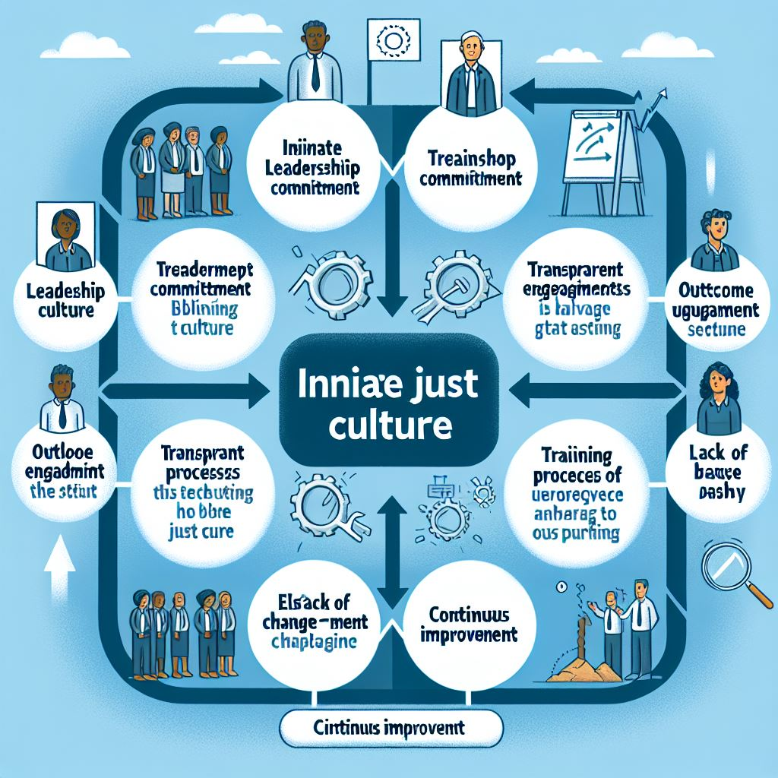
How It Will Flow
Initiate a Just Culture
Illustrate the process of implementing a just culture and the barriers at each step.

Slide 9

Conclusion
How can each role do these?
Leadership: Commit to fostering a just culture.
Organizations: Implement consistent processes and training.
Individuals: Embrace transparency and learning from mistakes.

Slide 10

Thank You
Resources:
Allspaw, J. (May 22, 2012). Blameless postmortems and a Just Culture. In Code as Craft. Retrieved from https://www.etsy.com/codeascraft/blameless-postmortems
Health Quality Council of Alberta. (n.d.). Overcoming barriers to a just culture. Retrieved from https://justculture.hqca.ca/overcoming-barriers-to-a-just-culture/
BMJ Open Quality. (2023). Overcoming barriers to a just culture. BMJ Open Quality, 12(2), e002237. https://bmjopenquality.bmj.com/content/bmjqir/12/2/e002237.full.pdf

